Slide 1



Detailed analysis and concept development of 20 e-services in Estonian public sector
Presentation of final report
Mihkel Lauk, Triin Tars, Andrus Sarv

Slide 2
Services analyzed in a report
Authority | Service
The Competition Authority | Coordination of the price formula and the price limit of heat
Civil Aviation Administration | Application for Part-66 aero technical employee license
 | Coordination of high-rise buildings and -facilities
Road Administration | Booking times for an examination
 | Pre-processing vehicle registration documents (for high value vehicles)
 | Setting limits
 | Ordering and storing license plates
 | Temporary license plate logbook
Tax and Customs Board (TCB) | Submission of income tax return
 | Scheduling of overdue tax liabilities
Ministry of Economic Affairs and Communications (MEAC) | Submission of business notice
 | Proceeding application for terms of engineering
 | Proceeding application for building permit
Agricultural Board | Coordination with other building (land improvement)
 | Recognition of company operating in organic farming
Information System Authority (ISA) | Opening service for agencies
Technical Surveillance Authority (TSA) | Chemicals – fact sheets
 | Proceeding building permits for railway facilities
Estonian Maritime Administration (EMA) | Registration of the ship passengers
 | Issue of documents for working at sea

Slide 3
Found innovation

Slide 4
Found innovation Standardized services
Civil Aviation Administration – Application for Part-66 aero technical employee license
Maritime Administration - Issue of documents for working at sea
State view: Central solutions for information systems that have similar functions.
Notes:
Central solutions for information systems that have similar functions

Slide 5
Found innovation Services added in one process
MEAC – Proceeding application for terms of engineering
MEAC – Proceeding application for building permit
Civil Aviation Administration – Coordination of high-rise buildings and -facilities
Proceeding applications for terms of engineering
Processing of building permit
Getting approvals
TSA – Proceeding building permits (railway facilities, building into water)
Agricultural Board – Coordination with other building (land improvement)
Client view: one service instead of five, transparent process.

Slide 6
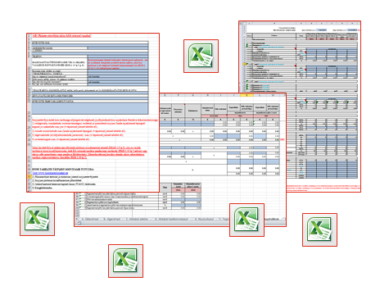
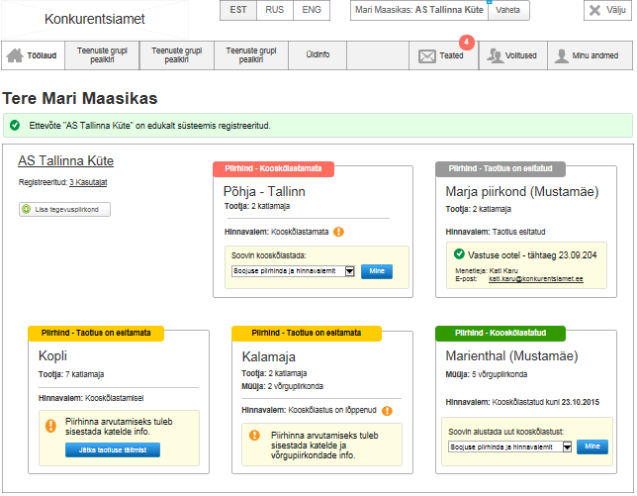
Found innovation Process automation – The Competition Authority – Coordination of the price formula and the price limit of heat
State view: less mistakes, shorter proceeding time

Slide 7
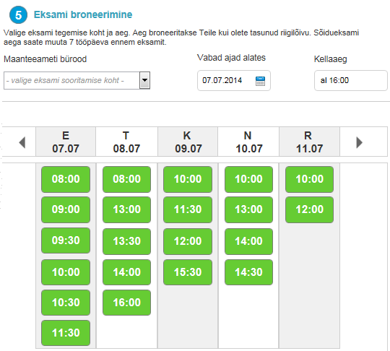
Found innovation Process automation – Road Administration – Booking times for an examination
State view: 50% less work

Slide 8

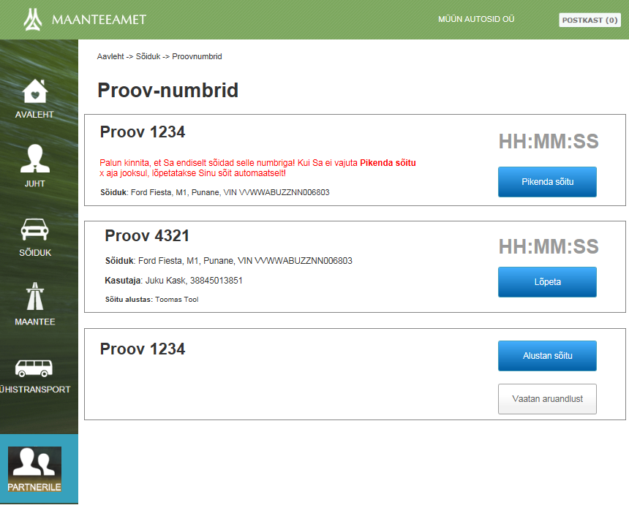
Found innovation Process automation – Road Administration – Temporary license plate logbook
PROOV-numbrimärkide logiraamat
Urercilla feu feugiam, quissed elisi eum velit praessequisi exero conse do dunt wisi er summolobor ad do od modip eu feuisl ing et, vel et iriuscinit, venit augiam irillaor amconum quat, conum iure exero dolutem amconum quat la facipis nibh et accummo dionull aorper si.
Client view: 50% less administration
State view: 1/3 less work

Slide 9
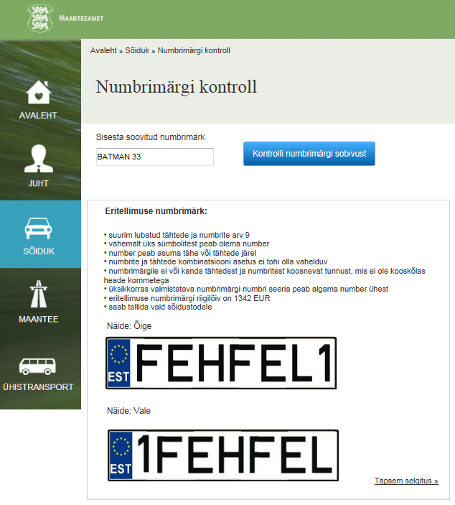
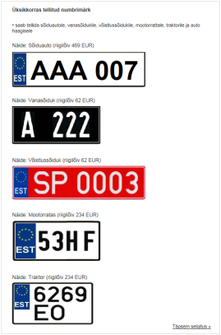
Found innovation Process automation – Road Administration – Ordering license plates (special license plate)
Client view: 3 times less administration

Slide 10
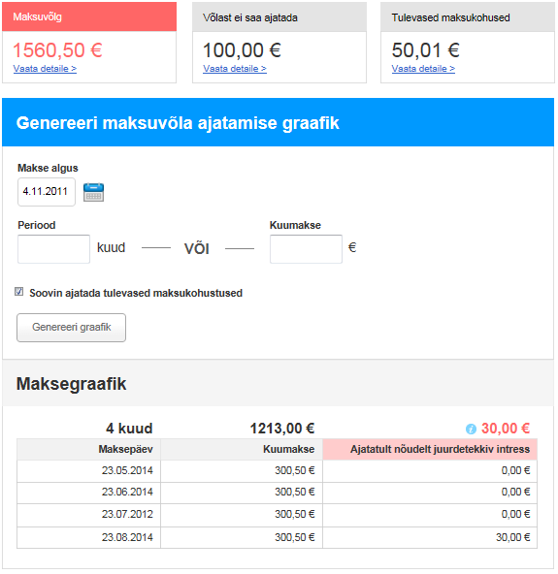
Found innovation Process automation – Tax and Customs Board – Scheduling of overdue tax liabilities
Client view: service is more beneficial.
State view: ~3800 requests fewer to process.

Slide 11
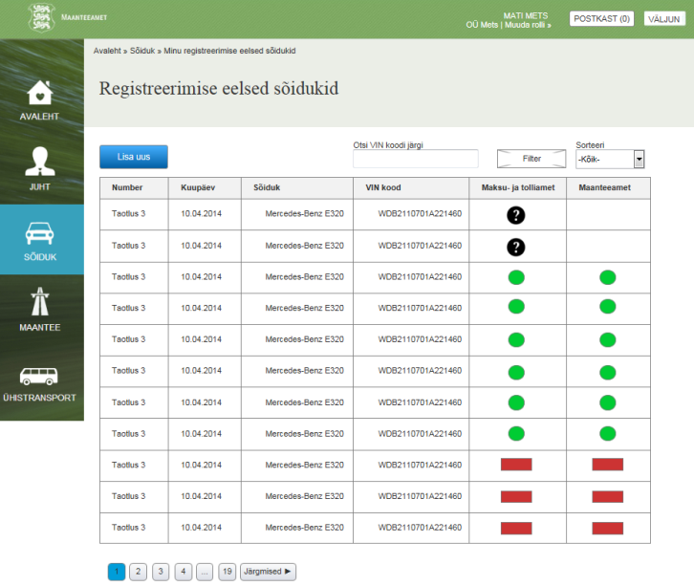
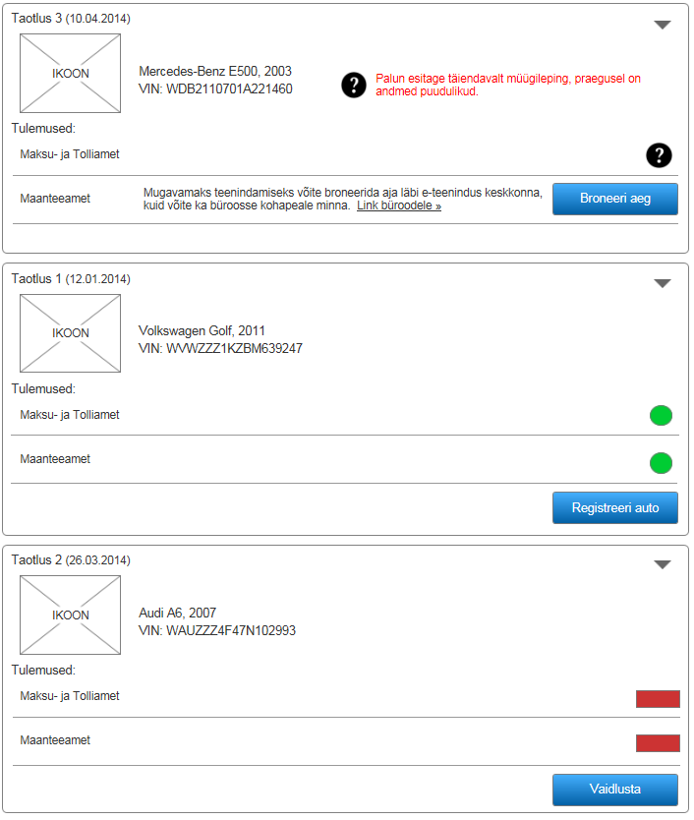
Found innovation Process automation – Road Administration – Pre-processing vehicle registration documents (for high value vehicles)
State view: ~350 000 € less work.
Client view: 40% less administration.

Slide 12
Found innovation Process automation – ISA – Opening service for agencies
Public service A
E-form
X-Road service (PEPE)
Public service C
Public service B
There are no E-services
Notification service
Public service D
E-form A
E-form B
Notification service
State view: Different service provides (local authority) for one service instead of many similar services, enabling key solutions, foundation of service portfolio.

Slide 13
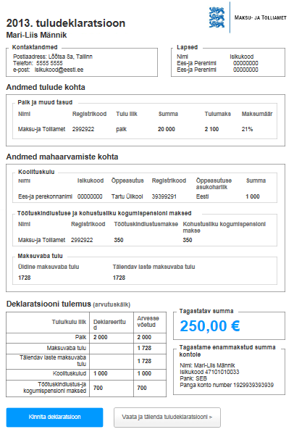
Found innovation Proactive service – TCB
70%
Society view:
state serves me, rather than I serve the state.

Slide 14
Found innovation Loss of services - MEAC
MEAC – Submitting notice of economic activity in a retail sector
Business Register Portal
+Proactive support for finding specific requirements on the basis of NACE
+ Venue info
+ Applying for operating permits and -notifications
Client view: for ~3100 entrepreneur easier to fulfill the duties.

Slide 15
Found innovation Loss of services - Agricultural Board
Agricultural Board – Recognition of company operating in organic farming
e-PRIA
Applying for organic farming support
Client view: Reducing administration for ~150 entrepreneur, total annual saving ~7200€.

Slide 16
Found innovation Loss of services - Road Administration
Road Administration – Setting limits
X-road service
State view: No need for moving ~60 000 documents annually, saving ~3 employees workforce, ~50% less administration for a client.

Slide 17
Indicators

Slide 18
Indicators today
Scheduling of overdue tax liabilities
Pre-processing vehicle registration …
Temporary license plate logbook
Booking times for an examination
Setting limits
Ordering and storing license plates
Application for Part-66 aero tech…
Recognition of company …
Coordination with other building …
Submission of business notice
Coordination of high-rise buildings…
Submission of income tax return
Coordination of the price formula …
Proceeding application for building ...
Registration of the ship passengers
Proceeding building permits for rail…
Issue of documents for working at sea
Opening service for agencies
Chemicals – fact sheets
Proceeding application for terms of engi…
Motivation is different.
Measuring does not only depend on the maturity of the organization.
Providing distributed services.

Slide 19
The popularity of indicators

Slide 20
Indicators in a future view
Service indicators in the present
Service indicators in the future

Slide 21
Risks

Slide 22
Risk matrix
Risk of lack of access to information
Risk of too open access to information
Risk of job loss
Risk of the complexity of processes
Risk of service design competencies
Risk of excessive information
Risk of domain management
Risk of developing one-time service
Risk of change management
Customer satisfaction risk
Team building risk
Juridical risk
Political risk
Risk of IT environment
Key personnel risk
Performance indicators risk
Risk of availability of information
Risk of accepting the restrictions
Risk of insufficient funding
The score for service

Slide 23
Risk ranking
High risk
Medium risk

Slide 24
Thank You!

